Slide 1

PRODUCT BY LEAPSCHOLAR
LeapBot
D E S I G N I N G T H E M V P A N D G T M S T R A T E G Y
BY: ABHISHEK SUMAN

Slide 2
PAINPOINTS OF STUDENTS
A student faces many problems while looking for opportunity to study abroad. Some of them are:
A student can apply to 4-5 universities only because of high application fees. So, finding the best university which might accept the application is challenging.
Budget constraints also should be kept in mind.
Campus culture needs to be known to the student before getting admitted to any university.
Visa application is a pretty tedious process, SOP & GTE needs to be filled and submitted very carefully.

Slide 3
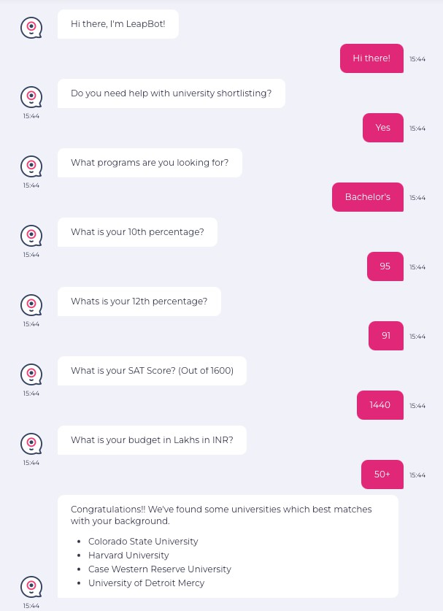
INTRODUCING
LeapBot
LeapBot, an AI-powered Chatbot, accelerates the university selection process for students by efficiently shortlisting prospective options. It reduces the need for extensive human intervention and makes the process much faster and more efficient.
TRY MVP YOURSELF

Slide 4
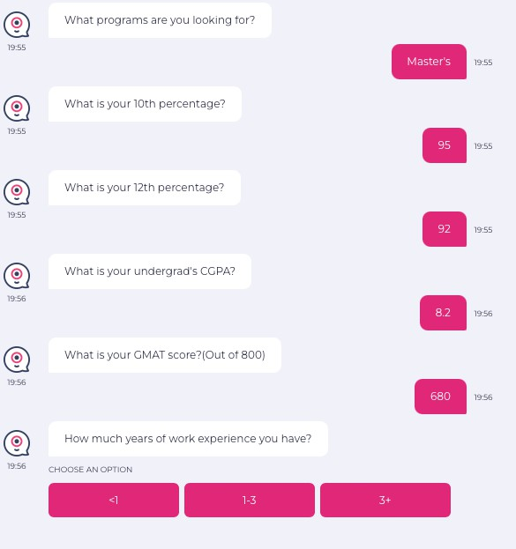
MINIMUM VIABLE PRODUCT(MVP)
of LeapBot
KEY FEATURES
LeapBot aims to solve every pain point of its users. Its features are:
Optimize university search in which chances of application getting approved are very high, taking into account academic background, work experience, budget, and location preference.
Provide community service by providing contact with students of that particular university.
Consultancy is provided for application which can be facilitated through LeapScholar.
Visa assistance is also provided which is again facilitated through Leap Scholar.
**MVP is built which features the 1st statement. Rest can be further done in further iterations.

Slide 5
ACHIEVING PRODUCT/MARKET FIT
Key Indicators
01
User Engagement: It denotes the initial traction our product is gaining.
02
Customer Feedback: It defines the initial feedback on our product. We can mould the product according to user needs in further iterations.
03
Conversion Rate: It defines how many students are getting acquired towards the end of the funnel.

Slide 6

PRODUCT POSITIONING & STATEMENT
LeapBot streamlines global education for students, addressing application challenges with AI. It optimizes university selection taking in account multiple factors, connects users with current students, and offers expert consultancy and visa assistance through Leap Scholar. This comprehensive solution ensures efficiency, community support, and expert guidance for a seamless study abroad journey.

Slide 7
SALES & MARKETING
STRATEGY
To gain initial traction, we’ll be using Social Media which LeapScholar is having strong hold on.
Start posting educational and awareness posts related to education in abroad. Create trending Instagram Reels & YT Shorts, which these platforms are heavily promoting.
Collaborate with influencers who are addressing this type of audience.
We can target Facebook and Telegram groups where opportunities are getting posted and promote LeapBot there for sustainable and organic leads.
Affluent schools can be targeted and, workshops and talks can be organized where leads can be converted.

Slide 8
PRODUCT LAUNCH PLAN
PRE-LAUNCH
LAUNCH DAY
POST-LAUNCH
Run informative campaigns across LeapScholar’s existing user base.
Invite a select group of users to participate in beta testing, and gather feedback to make necessary adjustments.
Leverage LeapScholar’s strong social media presence to tease about the upcoming launch and a Mega Event.
We can also engage with the audience through countdowns, sneak peeks and quizzes.
Roll out LeapBot with a phased approach, initially targeting a specific cohort of users who expressed interest during the pre-launch phase.
Host a Media Event to officially introduce LeapBot to the public.
Market the event with a big pool of prizes
including scholarships.
Implement feedback loops during the initial weeks post-launch and address any issues promptly.
Send onboarding emails to new users, guiding them on how to make the most of LeapBot.
Share success stories, testimonials, and updates about how LeapBot is benefiting students making use of momentum gained through marketing efforts.
Continue engaging with the audience on social media platforms.
Monitor key indicators such as user engagement, customer feedback, and conversion rates.
Organize webinars and workshops in partnership with schools to introduce LeapBot to students and educators.

Slide 9

THANK YOU
BY: ABHISHEK SUAMN

